Slide 1
AE Cloud2 Arduino Digilent GPS UART Header
By Michael Li 4/3/2019

Slide 2
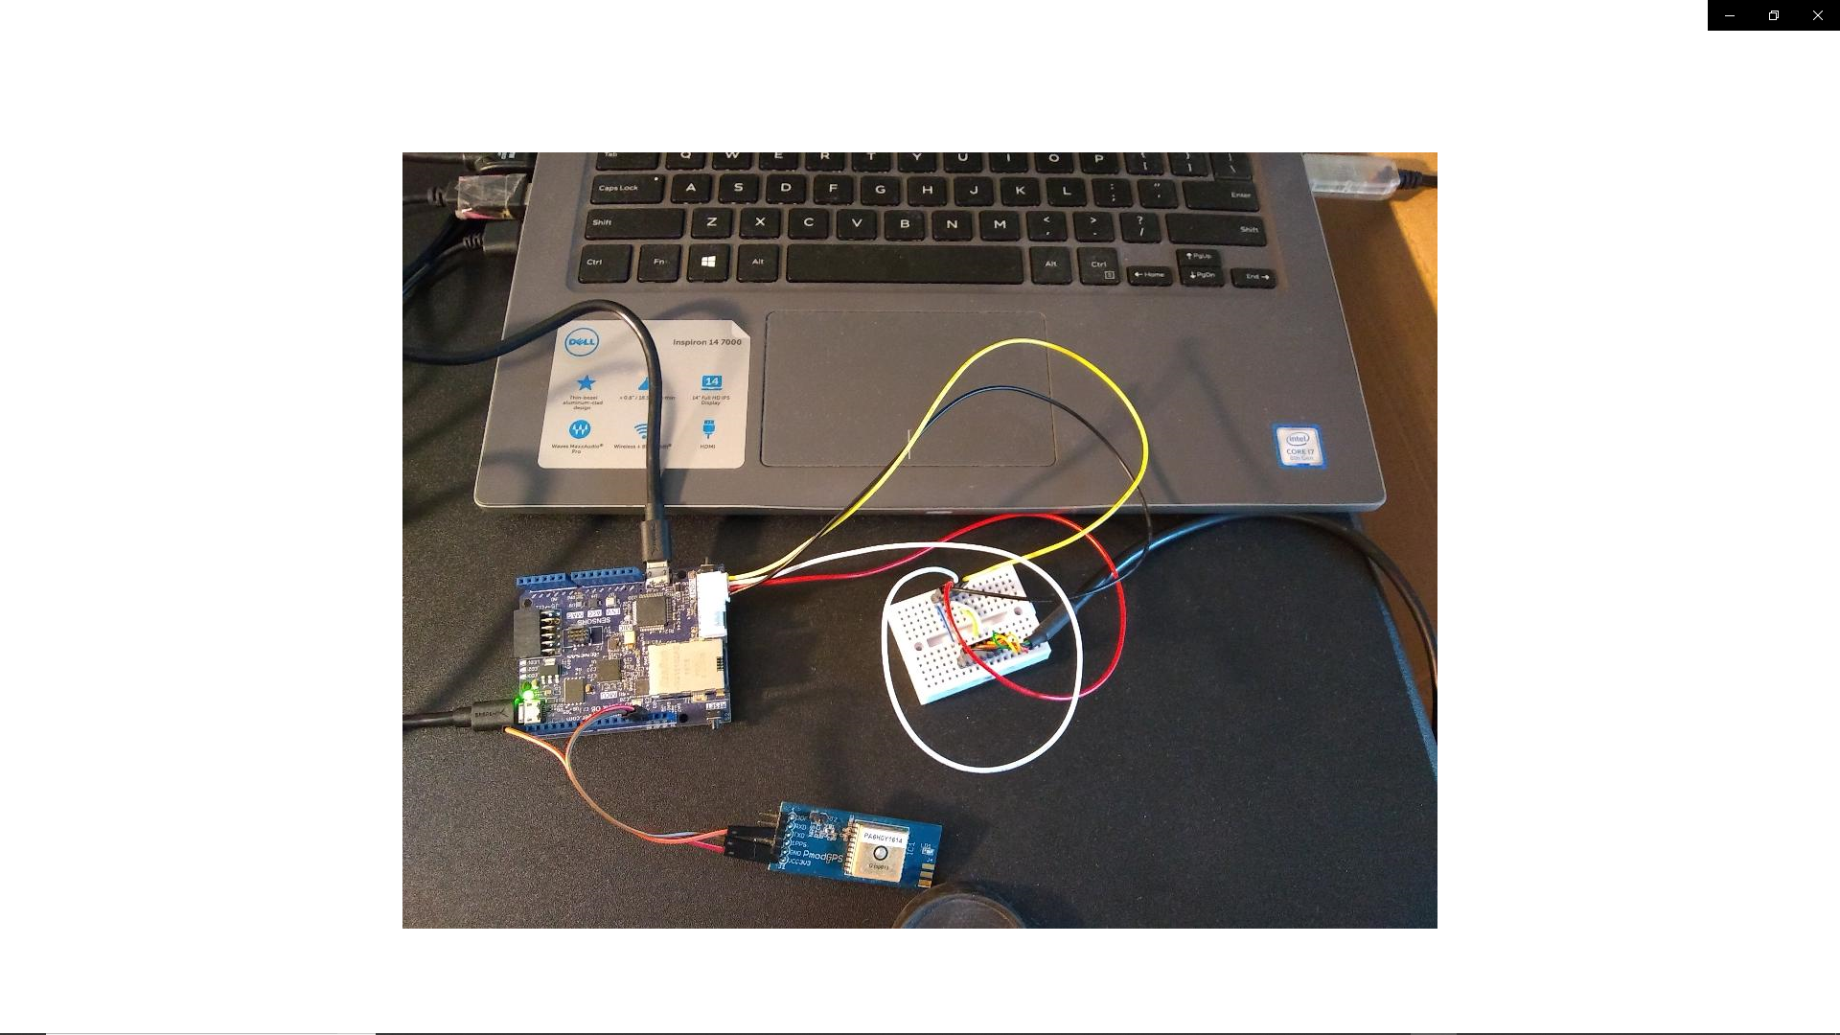
Serial 1 (Grove Header): UART to USB converter Serial 0 (Arduino Header) : GPS sensor

Slide 3
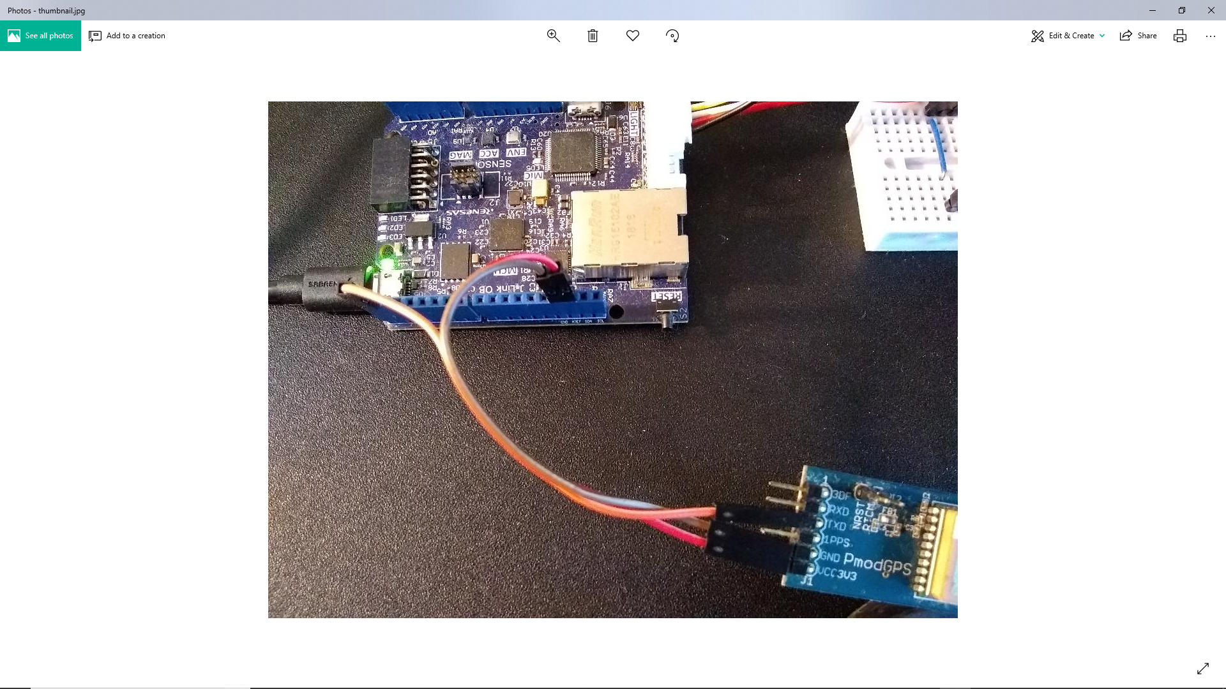
Serial 0 RX (D1) to TX (GPS sensor – orange wire) AVREF or 3.3V to 3.3V (GPS sensor – red wire) GND to GND (GPS sensor – brown wire)

Slide 4
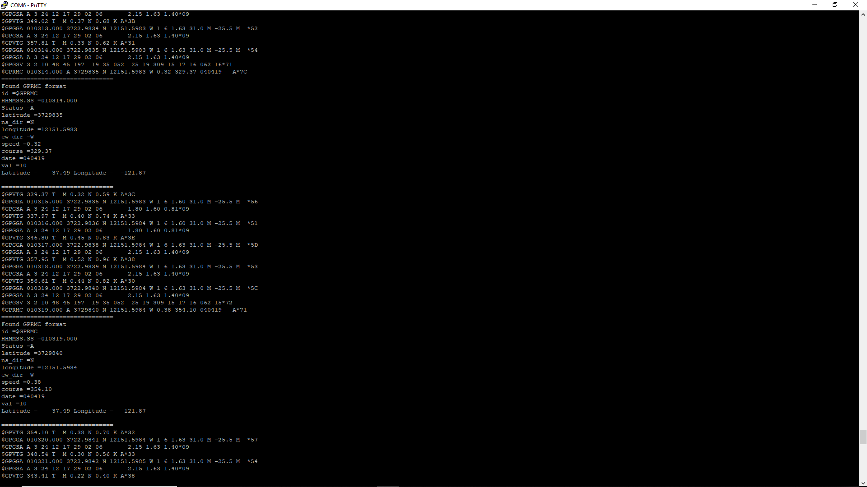
Output data: 1. GPS protocols are being displayed. 2. GPS location is extracted from GPRMC packet.

Slide 5
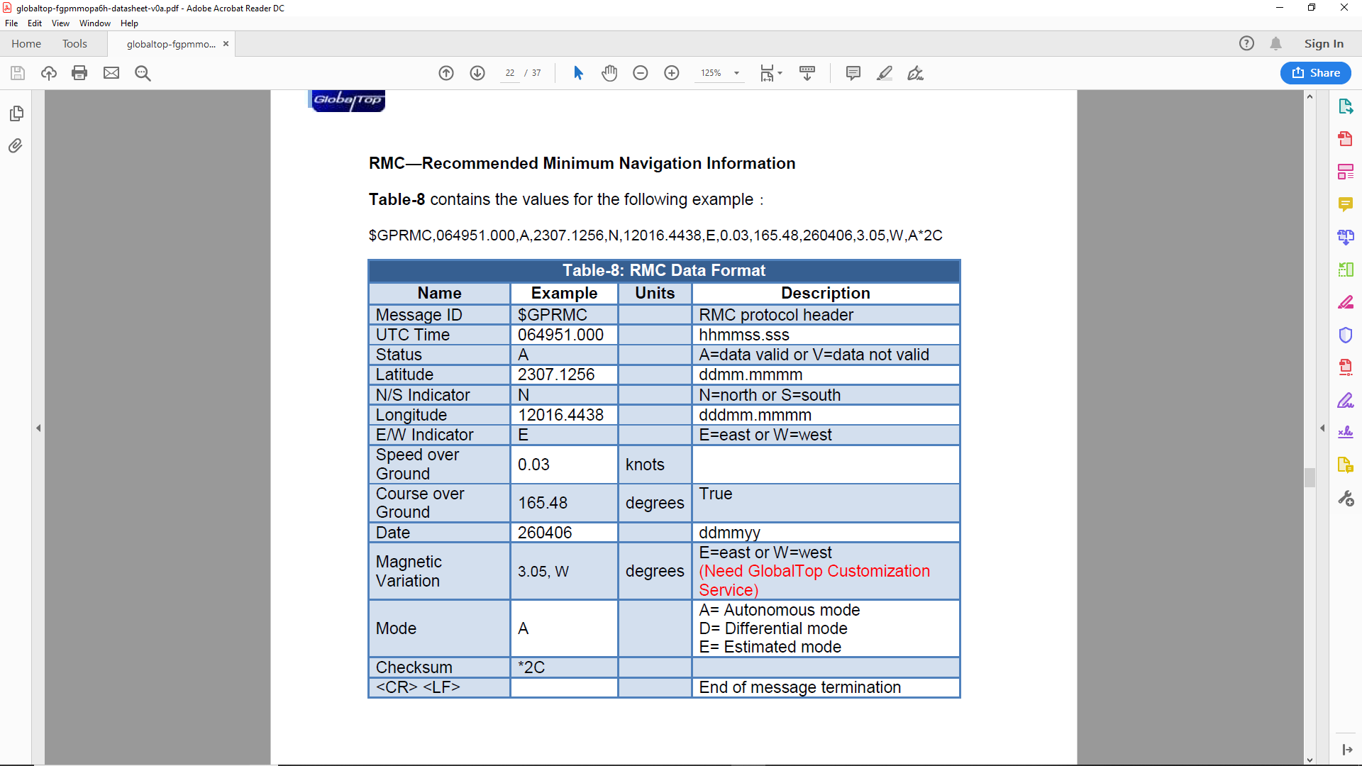
Data Packet Format

Slide 6
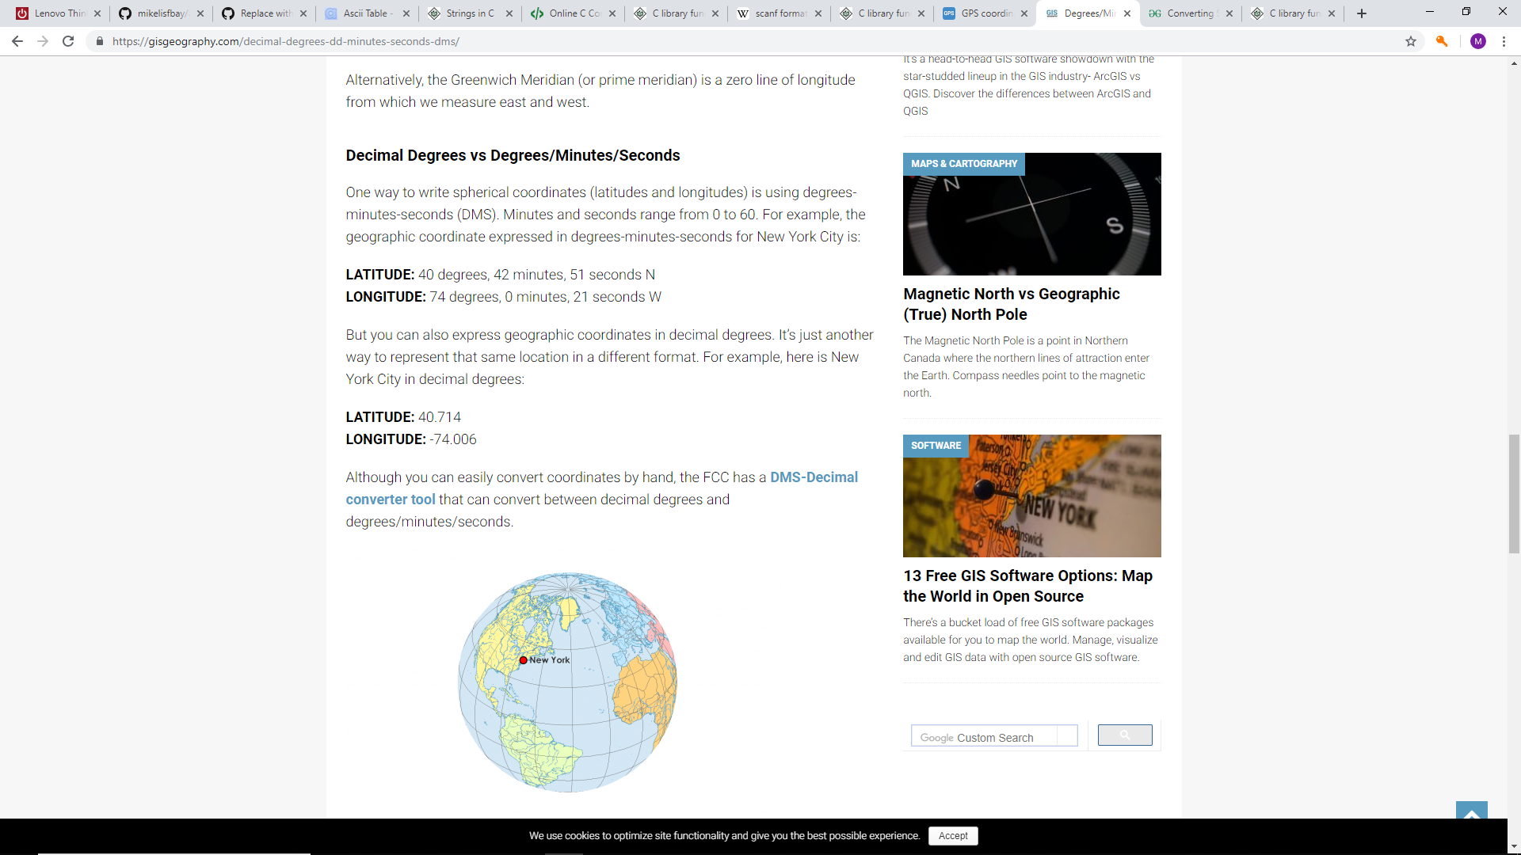
Conversion (DDMMSS to Decimal degree) Latitude: DDMM.SSSS N/S → DD+MM/60+ SS/3600 (South: negative number) Longitude: DDDMM.SSSS E/W → DDD+MM/60+ SS/3600 (West: negative number)

